Slide 1
Nike Shoe Inventory Management System

Slide 2

Company Background
Nike, Inc. is a global leader in the design, manufacturing, and marketing of athletic footwear, apparel, and equipment.
Founded on January 25, 1964, as Blue Ribbon Sports and officially becoming Nike, Inc. in 1971, the company has grown to become one of the most recognized brands worldwide.

Slide 3
System Objectives
Efficient Inventory Management
Accurate Reporting
Enhanced User Interaction
Data Integrity
Improved Decision Making

Slide 4
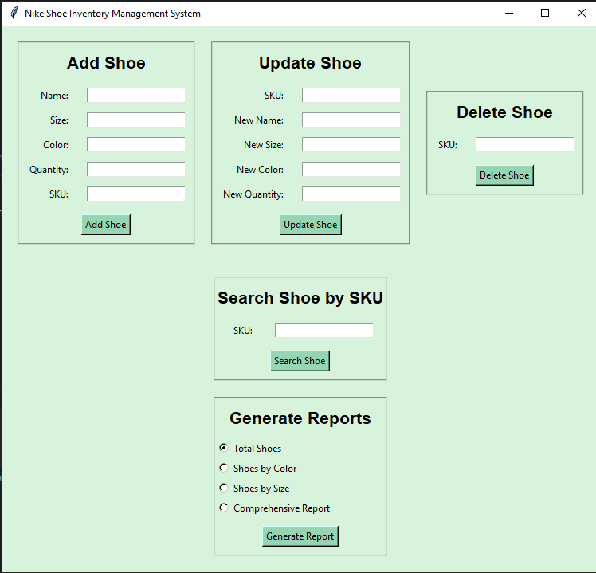
Modules
Complete GUI

Slide 5
Modules
GUI (main.py)
This module have the following attributes
Tkinter library for GUI
MessageBox for prompting messages
Five functions to connect front end with the backend which are
add_shoe_gui()
search_shoe_gui()
update_shoe_gui()
delete_shoe_gui()
generate_reports()

Slide 6
Inventory Management (inventory.py)
It has the following functions
load_inventory() (Loads the dictionary in the program)
Save_inventory() (Saves the data in the program to the dictionary)
add_shoe() (Add the shoe into the dictionary)
search_shoe() (Search the specific shoe in dictionary)
update_shoe() (Update the given shoe)
delete_shoe() (Delete the shoe in dictionary)
list_shoes() (Generate list of shoes)
All of these functions accepts inputs from the user (main.py) and utilizes it in background.

Slide 7
Reporting (report.py)
It has four attributes
Generate_total_shoe_report() (Generate report by adding all shoes)
Generate_shoes_by_color_report() (Generate report by Color)
Generate_shoes_by_size_report() (Generate report by Size)
Generate_comprehensive_report() (Generate report by giving all the attributes)

Slide 8
Shoe Class (shoe.py)
It is a class which is defining all the attributes to take from the user and is used in all the provided files.

Slide 9
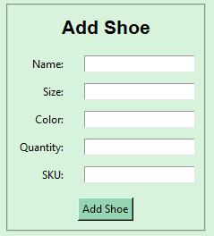
Working
Adding a Shoe
It accepts the following input
Name (String)
Size (Integer)
Color (String)
Quantity (Integer)
SKU (String)

Slide 10
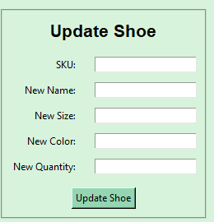
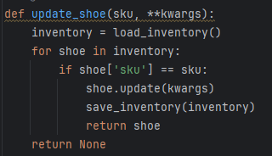
Working
Updating a Shoe
It accepts the following input
Name
Size
Color
Quantity
SKU
NOTE: You can press enter to keep the previous entry as it is.

Slide 11
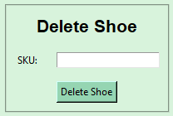

Working
Delete a Shoe
Enter SKU to search and delete from the database.

Slide 12
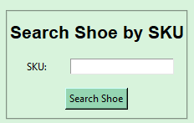
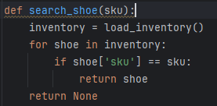
Working
Search a Shoe
Enter SKU to search from the database.

Slide 13
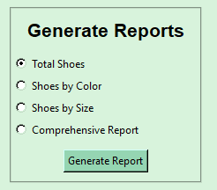
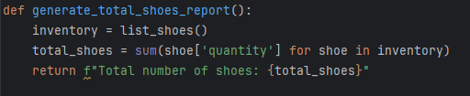
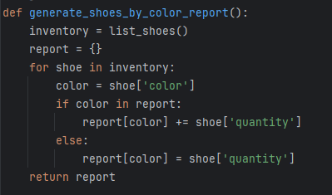
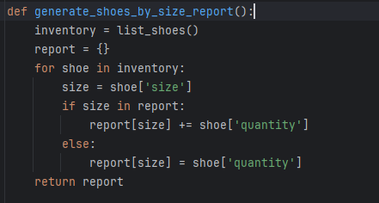
Working
Generate Reports
From these options you can select and Generate a Report of your own liking.

